Slide 1
Modularity
Richard A. Watson
ECS, Southampton University

Slide 2
Previously
Very simple kind of modularity
  Modules are completely independent
Today
  Types of modularity
  Nearly-decomposable systems (Simon)
  Hierarchical modularity
  Can a system be modular if the dependencies between modules are important?

Slide 3
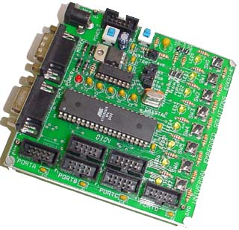

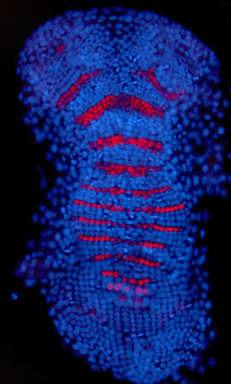

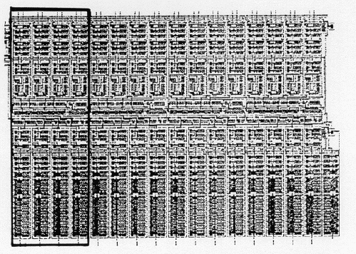
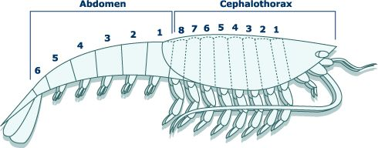
Types of modularity: repetition
Repetition

Slide 4
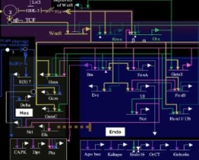
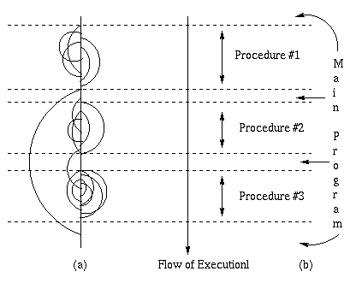
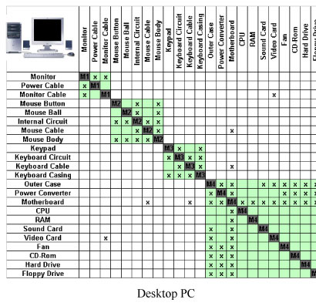
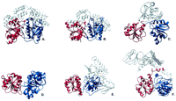
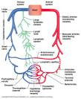
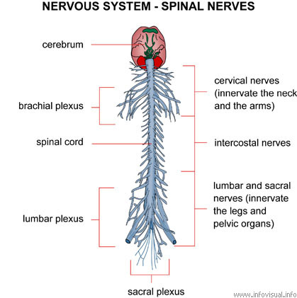
Types of modularity: Functional decoupling

Slide 5
Re-use
Both types of modularity imply re-use
  Repeated modularity – re-use in a single device/organism
  Functional decomposition – allows re-use in other devices/variants
  Self-contained functionality in both
Assuming modularity reflects inherent structure of the problem/design space
  Repeated modularity implies self-similarity in sub-problems
  But functional decomposition does not
Divide and conquer
  Consider train schedule in clustered distribution of cities
  Timetabling across a university

Slide 6
Significance of Modularity for
Understanding networks
  Identification of modular subnetworks within complex networks is useful for understanding/modelling/predicting network dynamics.
  Semi-independent dynamics for each module
  Modularity often defined structurally/topologically:
  Weak or sparse connections between subnetworks
The evolvability of complex systems
  Fit configurations of an evolving system may be more or less easy to discover depending on the inherent modularity of the environment/problem domain of that evolving system:
  Intuitively, because modifications to one subsystem (subset of parameters) has less interference on operation of other subsystems
Notes:
Contrast: evolve a system and see if its modular vs given a modular domain how easy is it to evolve

Slide 7
Basic concepts of modularity
Structural: Topological / connectedness
  Number of connections within a module, vs
  number of connections between modules
Functional decomposition
  Do changes in one module affect results of changes in another module (intra- and inter-module epistasis)
  Wrt dynamics, behaviour, fitness?
Note that structural modularity ≠ functional modularity…

Slide 8
How important are the inter-module dependencies?
Structural modularity, dynamic/behavioural/functional modularity, fitness modularity
  The behaviour of a dynamical system, (dynamical properties e.g. attractors), may be radically altered by states of variables in remainder of system
  If dynamical properties are strongly interdependent then functional/behaviour properties of a module are not independent of context → fitness contributions
Consider intra-cell vs inter-cell interactions
  Although internal dynamics may be complex they are encapsulated (physically) from dynamics of other cells
  Yet, inter-cell communication is critical in proper functioning of cell
  Encapsulation of dynamics ≠ interdependencies are unimportant
Notes:
Compare: topological properties of networks, complexity of (dynamics of) networks

Slide 9
What does modularity mean wrt fitness interactions?
Doesn’t modularity mean that intra-module dependencies are more important (have a larger effect on fitness) than inter-module dependencies (by definition)?
  If pertinent properties of subsystems are strongly interdependent then it wasn’t modular, right?
How can it be the case that inter-connections are critical yet system exhibits meaningful modularity (that enhances evolvability) ?

Slide 10
Coming up…
Modularity in complex dynamical systems
Represented as modular network of interactions
Structural modularity does not imply weak interdependence of dynamical properties
How can it be the case that interdependencies are strong but modularity is meaningful?
Modularity in engineered and evolved systems: Simon (1969). provides concepts but examples are incomplete
Modularity in fitness: EC test problems also incomplete
An example: modular dynamics and fitness modularity
Quantify decomposability wrt fitness
Discuss impact for evolvability

Slide 11
Simon (1969): “nearly-decomposable” systems
“the short-run behaviour of each of the component subsystems is approximately independent of the short-run behaviour of the other components” and
“in the long run the behaviour of any one of the components depends in only an aggregate way on the behaviour of the other components”.
This is a dynamical description of modularity (rather than topological/structural, behavioural/functional)
It does NOT necessarily mean that interactions between modules are weak or unimportant (although Simon generally implies that it does)
  Let’s examine some of Simon’s own examples

Slide 12
A combination lock
a combination lock has 10 dials, each with 100 positions
  by blind trial-and-error we would expect to need on average half of 100¹⁰ guesses to find the combination that opens the lock
a ‘defective’ lock where a click can be heard when the dial is at the correct setting.
  requires on average about half of 10×100 guesses (merely 10 independent repetitions of finding the correct setting for each dial).
Combinatorics are clear here, but
The task of finding the correct setting for a dial is completely independent of setting on other dials
Hierarchical example?

Slide 13
Watchmakers’ parable
When either watchmaker is interrupted the currently assembly or sub-assembly they are working on falls apart – wasting time
One watchmaker assembles watches made of 1000 components
  An interruption almost always occurs before completion
The other assembles watches made of 10 modules, each of which is comprised of 10 sub-modules, each of which is comprised of 10 components.
  A few more steps, but good chance that an intermediate stable module is reached before an interruption occurs
Combinatorics, and hierarchy but
Search configuration space vs incremental stability in stochastic assembly
  The correct way to assemble each module is independent of the configuration of all other modules, never need to change a previously assembled module
  Consider adding modules of 10 parts sequentially

Slide 14
Heat exchange between rooms in a building
 | 1 | 2 | 3 | 4 | 5 | 6 | 7 | 8
1
2
3
4
5
6
7
8
A building with many rooms and cubicles
  Cubicles start at different temperatures
  Heat exchange rates are greater for cubicles in the same room than cubicles in different rooms
This has the dynamics that Simon
described:
  Short term temp of cubicle effected only
  by temp of other cubicles in the same room
  Long term temp of cubicle affected by (mean)
  temperature of cubicles in other rooms
It’s a hierarchically modular dynamical system:
What has it got to do with evolvability?
Whats the problem here? ‘finding minimal energy states’?
slower in modular system than in uniform Minimization of free energy has no locally stable configurations
Heat exchange coefficients
(≈ covariance matrix)

Slide 15
Dependency networks in (some) EC test problems:
NK landscapes
K=0 medium K high K

Slide 16
Dependency networks in (some) EC test problems
a) Unstructured
(NK landscapes)
b) Independent
(Royal Roads)
c) Clustered dependency (NKC)
No modularity
or hierarchy
Modularity but no hierarchy
most of benefit from optimising lowest level modules
Else,
‘turns inside out’

Slide 17
Other examples of modularity in EC
Separable
  Royal Road
  Concatenated trap functions
  ‘real Royal Road’
Non-separable
  ‘simple two-module problem’

Slide 18
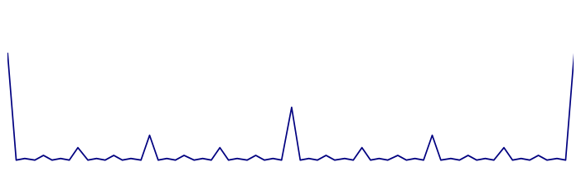
Scale-invariant difficulty (Hierarchical consistency)
Intra-block
Inter-block
Resultant landscape
Royal roads
Concatenated traps
NKCs
HIFF

Slide 19
Summary of examples
Simon
  Lock doesn’t make sense hierarchically because the unique correct position for each dial is independent of other dials – solve all the dials = solved the whole thing
  Watch makers: the unique correct assembly for each module is independent of other modules – sequential assembly of additional modules
  Heat exchange is hierarchically modular – but what has it got to do with evolvability?
EC
  Tunable amount of interdependency, tunable topological modularity, but, if inter-module dependencies are too strong then they seem to ‘subvert’ the modularity.
  If inter-module dependencies matter less than intra-module dependencies, then additional hierarchical levels are less and less significant

Slide 20
Alternatives…
There can be important interdependencies between variables within modules AND between modules,
(without ‘undoing’ the modularity)
  If effects can be aggregated, we can reduce dimensionality of system: encapsulation ≠ approximate independence
  See
    Hierarchical IFF (Watson 1998) and
    ‘modular interdependency in complex dynamical systems’ 2005
    Ising models

Slide 21
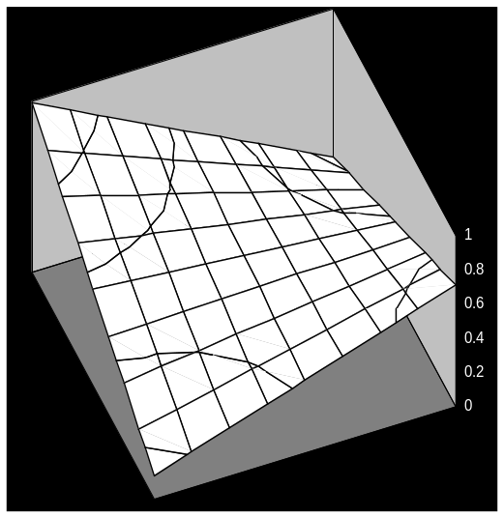
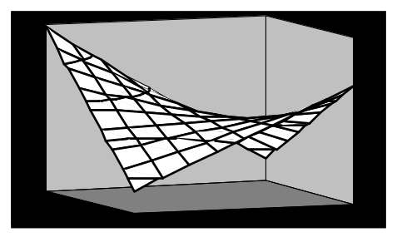
An example system: Difficult epistasis = ‘interdependency’
e.g. 11>00>01>10
1
A
0
0
B
1
11
00
10/01
IFF, (XOR)

Slide 22
An example system: primitive dynamics
Each edge in a graph exerts a (bi-stable) attraction in state of connected variables
2
stability
1
Possible topologies
  Regular lattice:
    1d (no local optima)
    2d (local optima)
      Particular temperatures are scale free (maximise complexity?)
  Irregular, limited connectivity
    → NKs (fitness function version of the RBN)
  Fully connected:
    Generally uninteresting
    Modularity in ‘strength’ of connections

Slide 23
Topologies
Dependency
network
stability
pairwise interdependency
2
stability
1
2
uniform interdependency
1
3
stability
4
particular cross-section
2
modular interdependency
?
1
3
stability
fitness
4

Slide 24
Larger modules, wider fitness saddles
6
 | 1 | 2 | 3 | 4 | 5 | 6 | 7 | 8
1 | - | 8 | 8 | 8 | 1 | 1 | 1 | 1
2 | 8 | - | 8 | 8 | 1 | 1 | 1 | 1
3 | 8 | 8 | - | 8 | 1 | 1 | 1 | 1
4 | 8 | 8 | 8 | - | 1 | 1 | 1 | 1
5 | 1 | 1 | 1 | 1 | - | 8 | 8 | 8
6 | 1 | 1 | 1 | 1 | 8 | - | 8 | 8
7 | 1 | 1 | 1 | 1 | 8 | 8 | - | 8
8 | 1 | 1 | 1 | 1 | 8 | 8 | 8 | -
5
7
2
3
8
1
4

Slide 25
Hierarchical modules, more local optima
6
1
2
3
4
5
6
7
8
1
-
16
8
8
1
1
1
1
5
7
2
16
-
8
8
1
1
1
1
2
3
8
8
-
16
1
1
1
1
3
8
4
8
8
16
-
1
1
1
1
1
5
1
1
1
1
-
16
8
8
4
6
1
1
1
1
16
-
8
8
7
1
1
1
1
8
8
-
16
8
1
1
1
1
8
8
16
-
Maximal stability at either one of two states
  large changes in state required to decrease energy/increase fitness

Slide 26
Decomposition preliminaries
A proposed decomposition is a subset of the variables (bi-partition)
If this decomposition is a ‘valuable’/’useful’ one – then the ‘properties of interest’ for the subsystem should be semi-independent of ‘context’ i.e. the remainder of the system
  e.g. the setting/s that open the lock
  e.g. stability of state/s in a dynamical system/ network
  e.g. the best/fittest configuration
But not completely independent

Slide 27
Decomposability of example?
B
Can we say which configuration of module A maximizes stability of the system without knowing the state of the context (i.e. B)?
2
1
3
A
4
B=
Consider the stability of module A for different configurations of B
stability
average
B=
State of A
Ans: No. The most stable configuration of A in some contexts is entirely different from that for other contexts

Slide 28
So
The network is clearly structurally modular
  By strength/number of connections
Dynamical properties of any subsystem (in this case, the most stable configuration) are strongly dependent on the state of context
  So maybe, this system is not modular wrt this property (despite structural modularity)
But…

Slide 29
In the example system
B=
stability
average
B=
State of A
4 possible configurations of A.
Of these, are never the most stable configurations of A
We don’t know exactly which config. of A is most stable (without knowing context) but we do know its one of these two ( ).

Slide 30
Quantifying decomposability
C, total number of different configurations for the module
M, how many different configurations of the module might be required to maximise fitness
  E.g. contexts can be put into classes by the configuration of the module that maximises fitness
  M is the number of different equivalence classes in the set of all possible contexts (wrt measured property of interest in the module)
M provides a quantifiable measure of the quality of a proposed decomposition (counting # of equivalence classes wrt p.o.i.)
  M=C: this decomposition provides no utility
  M=1: No interaction between modules = “separable” (no hierarchy is possible, RRs)
  1<M<C: system is “decomposable but not separable”
  We know something about how to optimise A independently of context, but not everything (decrease size of set, but not nec. proximal members)

Slide 31
Comparison with Mutual Information
See Dauscher, Polani, Watson 2006
Both measures of the information that context provides about a module
  MI – state of context to state of module
  Here – state of context to which state of module maximise fitness (or other p.o.i.)

Slide 32
Comparison with Mutual Information
See Dauscher, Polani, Watson 2006
Both measures of the information that context provides about a module
  MI – state of context to state of module
  Here – state of context to which state of module maximise fitness (or other p.o.i.)
Complexity: sum of MI over all possible partitions at all scales:
  Some partitions would give different MI measures than others
  Modularity might be related to how different MI of some partitions is to MI other partitions
More of an emphasis on hierarchical modularity
  How does H relate to maximisation of complexity measure?

Slide 33
Evolvability
In next lecture we’ll look at how hierarchical modularity of this form impacts evolvability
Briefly,
If we interpret ‘stability’ as a property to be maximised in searching state configurations – i.e. fitness
  Its easy to find moderately stable configurations, where no small change increases stability
  Further increase in stability requires changes in state of many variables simultaneously
A gradual mechanism of evolution that searches local variations
    Hill-climber, (GA without crossover, GA without diversity maintenance)
  Time to find most fit configuration increases exponentially with number of problem variables,
  Time to next fitness improvement increases exponentially

Slide 34
Clustered dependency ↔ hierarchical dependency
Use pair-wise dependency, applied at many hierarchical levels
Same kind of interdependency between groups at all levels
‘aggregate effects’
‘emergent
genes/ features’
genes/ atomic features

Slide 35
Interdependency acting through aggregate effects
A
B
A
B
A
B
A
B
A modular system of four variables
Inter-module dependencies abstracted into single dependency between aggregate states of modules
aggregate state depicted as higher-level variable
aggregate states at higher levels are phenotypic effect of many genes
In these cases, interdependencies between higher level effects may be stronger without ‘overpowering’ intra module interdependencies.

Slide 36
Discovering modularity
“SEAM”, for example, uses assumption that problem is modular, but uses no a priori information about where the modules are (which variables are dependent on which others).
Discovers and exploits the modularity dynamically. Can output the tree of dependencies corresponding to hierarchical decomposition

Slide 37
Summary
Modular systems can have significant dependencies between modules
Simon provides a hierarchical notion of modularity (in complex dynamical systems), and combinatorial stories of modularity effecting evolvability of complex systems: but the examples don’t quite bridge former to the latter
An example dynamical system that is structurally modular and showed that its dynamics are strongly interdependent. But it can be decomposed..

Slide 38
Algorithms that (tried but failed) to discover modularity/automatic problem decomposition
Inversion operator
Linkage learning GAs (Harik 1990s)
Messy GA (Goldberg 1991)

Slide 39
Algorithms that discover modularity/automatic problem decomposition
Model-based opt: EDAs (Pelican 2002ish) eg PBIL, BOA
SEAM (Watson 2002)
BBHC (Iclanzan 2007ish)
‘MACRO’ (Mills 2010)
Hopfield network models (rHN-G) (Watson et al)
Linkage Tree GA – Theirens 2010ish
“P3” - (Thierens 2010), Goldman and Punch 2014)
Schema Grammar – Cox 2014ish
Deep optimisation – Caldwell (2017)

Slide 40
Summary
Modular systems can have significant dependencies between modules
Simon provides a hierarchical notion of modularity (in complex dynamical systems), and combinatorial stories of modularity effecting evolvability of complex systems: but the examples don’t quite bridge former to the latter
An example dynamical system that is structurally modular and showed that its dynamics are strongly interdependent. But it can be decomposed..
Suggested a means to quantify the value of a proposed decomposition given a using equivalence classes of contexts

Slide 41
Conclusions
Don’t assume that modularity ≈ independent sub-parts
‘decomposability’ – only need to consider limited number of configurations of a subsystem
  Decomposable but not separable, is where the interesting cases are
Evolvability of complex systems
  Separable and nearly separable systems are easy to optimise/evolve
  Decomposable systems are easily evolvable with appropriate mechanisms (see ‘compositional evolution’ lecture) but hard for naive methods

Slide 42
Discussion points
The balance of weights ‘just right’, vs
higher order interactions
Dynamical Hierarchies
    What is a DH
    Do we see more than one level of emergence in ALife models
    Protecting lower levels from deformation by higher-level pressures

